Slide 1
Lecture_08

Slide 2
No. 51

Slide 3

Arithmetic
Progressions
Sums based on a_{n} and S_{n} formula

Slide 4
Exercise 5.3 14
14) Find the sum of the odd numbers between 0 to 50.
Sol:
1,
The odd numbers between 0 to 50 are as follows:
3,
5,
7,
...
49.
and d =
These numbers form an A.P. with a =
2
1
To find number of terms check which term is 49. Because its the last term
To find S_{n}
Let a_{n} = 49
Number of terms is not known
We know that for an A.P. ,
Difference between consecutive terms
are same
For given value of a_{n} Let us use the formula
a_{n} =
a + (n – 1) d
=
+ (n – 1)
Substitute value of a & d
∴ 49 =
1
2
1 + 2n – 2
=
∴ 49 =
∴ S₂₅ = 625
∴
49
=
2n – 1
∴
50
∴ Sum of odd numbers between 0 to 50 is 625
=
2n
We have to find S₂₅
∴
n
=
25
S_{n} =
∴ S₂₅

Slide 5
No. 52

Slide 6
Arithmetic
Progressions
Relationship between a_{n} and S_{n}

Slide 7
a₁
a₂
a₃
a₄
a₅
1,
3,
5,
7,
9,
…
S₁ =
a₁
a₁ =
S₁
1
S₂ =
S₁ + a₂
1 + 3
a₁ + a₂
a₂ =
S₂ – S₁
a₁ + a₂ + a₃
S₃ =
S₂ + a₃
1 + 3 + 5
a₃ =
S₃ – S₂
a₁ + a₂ + a₃ + a₄
S₄ =
S₃ + a₄
1 + 3 + 5 + 7
a₄ =
S₄ – S₃
S_{n} =
Sum of first n terms

Slide 8
No. 53

Slide 9
Arithmetic
Progressions
Sum Based on relationship
between a_{n} and S_{n}

Slide 10
Exercise 5.3 11
11) If the sum of the first n terms of an AP is 4n – n²,What is the first term ? What is the sum of the first two terms? What is the second term? Similarly, find the 3rd, 10th and n^{th} terms.
Find a₁
Find a₂
a₁ = S₁
Sol:
S_{n} = 4n – n²
Find S₂
4
S₁ =
(1)
– (1)²
= 4 – 1
= 3
3
a₁ =
S₁ =
S₂ =
To find S₁ put n = 1
4
(2)
- (2)²
= 8 - 4
= 4
a₂ =
S₂ – S₁
= 4 - 3
= 1
Lets find value of d
d = a₂ – a₁
= 1 – 3
= - 2
To find S₂ put n = 2
a₃ =
a + 2d =
3 + 2(-2)
= 3 – 4
= – 1
a₁₀ =
a + 9d =
3 + 9(-2)
= 3 – 18
= – 15
a_{n} =
a + (n – 1) d
=
3
+ (n – 1)
(-2)
=
3
– 2n + 2
∴ a_{n} =
5 – 2n

Slide 11
No. 54

Slide 12
Arithmetic
Progressions
Word problems based on S_{n} formula

Slide 13
Exercise 5.3 15
15) A contract on construction job specifies a penalty for delay
of completion beyond a certain date as follows: Rs.200 for the first day,
Rs.250 for the second day, Rs.300 for the third day, etc. the penalty for each
succeeding day being Rs.50 more than for the preceding day. How much money
the contractor has to pay as penalty, if he has delayed the work by 30 days?
Lets make a list of amount of penalty for each succeeding day
Sol:
Amount of penalty for each succeeding day are as follows:
200,
250,
300,
. . .
We need to find penalty for 30 days
i.e. S₃₀
These numbers form an A.P.
with a = 200
and d =
250 – 200
= 50
Penalty for delayed work by 30 days =
S₃₀
We know that,
For S₃₀ substitute,
n = 30, a = 200 & d = 50
S_{n} =
∴ S₃₀ =
∴ S₃₀ =
∴ Penalty for delayed work by 30 days is Rs.27750.

Slide 14
No. 55

Slide 15
Arithmetic
Progressions
Word problems based on S_{n} formula

Slide 16
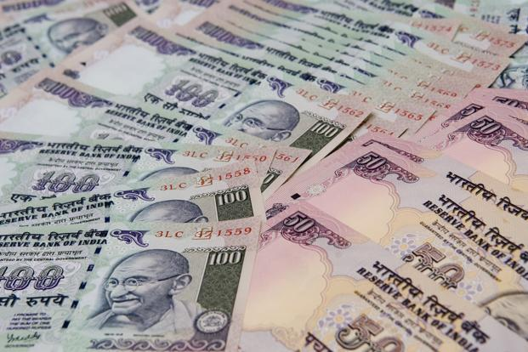

Exercise 5.3 16
16) A sum of Rs.700 is to be used to give seven cash prizes to
students of a school for their overall performance. If each prize is
Rs.20 less than its preceding prize, find the value of each of the prizes.
That means total of seven cash prizes given is Rs.700
i.e. S₇ = 700
Sol:
Since, value of each prize is Rs.20 less than its preceding prize.
These amounts forms an AP
For example:
∴ Value of each successive prizes form an A.P.
where d =
- 20
If,
1st prize: Rs.200
Total amount to be used to give 7 cash prizes =
S₇
= 700
then,
2nd prize: Rs.180
3rd prize: Rs.160

Slide 17
16) A sum of Rs.700 is to be used to give seven cash prizes to
students of a school for their overall performance. If each prize is
Rs.20 less than its preceding prize, find the value of each of the prizes.
Sol:
Since, value of each prize is Rs.20 less than its preceding prize.
∴ Value of each successive prizes form an A.P.
where d =
- 20
Total amount of cash prize given =
S₇
= 700
We know that,
Substitute
n = 7, d = -20 & S₇ = 700
∴ a =
160
S_{n} =
For given value of S₇
Since, value of each prize is Rs.20 less than its preceding prize.
∴ S₇ =
∴ Value of each prize are Rs.160,
120,
140,
100,
80,
60
& 40
respectively.
∴ 700 =
100
∴ 700
∴ 200 =
2a – 120
∴ 200 + 120 =
2a
∴ 2a =
320

Slide 18
No. 56

Slide 19
Arithmetic
Progressions
Word problems based on S_{n} formula

Slide 20
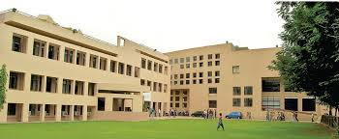

Exercise 5.3 17
17] In a school, students thought of planting trees in and around the
school to reduce air pollution. It was decided that the number of tree, that each
section of each class will plant, will be the same as the class, in which they are
studying, e.g., a section of Class I will plant 1 tree, a section of Class II will plant
2 trees and so on till Class XII. There are three sections of each class. How many
trees will be planted by the students ?
Sol:
The number of trees planted by each class are as follows:
1,
2,
3,
…
12
These numbers form an A.P.
with a = 1
, d =
2 – 1
= 1
and a_{n} = 12
That means we need to find total no. of trees planted by students till class XII i.e. S₁₂
No. of trees planted by each class form an AP
Class I
Class II
Class III

Slide 21
17] In a school, students thought of planting trees in and around the
school to reduce air pollution. It was decided that the number of tree, that each
section of each class will plant, will be the same as the class, in which they are
studying, e.g., a section of Class I will plant 1 tree, a section of Class II will plant
2 trees and so on till Class XII. There are three sections of each class. How many
trees will be planted by the students ?
Sol:
The number of trees planted by each class are as follows:
1,
2,
3,
…, 12
These numbers form an A.P.
with a = 1
, d =
2 – 1
= 1
, a_{n} = 12
We know that,
∴ Total number of trees planted by 1 section of each the class = 78
For S₁₂ substitute,
n = 12, a = 1 & d = 1
S_{n} =
That means we need to find total no. of trees planted by students till class XII i.e. S₁₂
∴ Total number of trees planted by 3 sections of each the class =
[1 + 12]
3 × 78 =
234
∴ S₁₂ =
Total trees planted by the students
will be 234.
[13]
∴ S₁₂ = 78

Slide 22
No. 57

Slide 23
Arithmetic
Progressions
Word problems based on S_{n} formula

Slide 24
Exercise 5.3 18
18) A spiral is made up of successive semicircles, with centers
alternately at A and B, starting with center at A of radii 0.5cm,1.0cm,1.5cm,..
What is total length of such a spiral made up of 13 consecutive semicircles?
Sol:
Means there are two different centers A & B which are used alternately
πr
Length of a semicircle =
We need to find S₁₃
∴ Length of successive semicircles are,
0.5π,
1π,
1.5π,
…
That means we need to find total length of 13 semicircles i.e. S₁₃
These numbers form an A.P.
with a = 0.5π
and d =
1π – 0.5π
= 0.5π
3rd semicircle
5th semicircle
Radius of 3rd semicircle 1.5cm
∴ Length = 1.5π cm
Radius of 1st semicircle 0.5cm
∴ Length = 0.5π cm
Circumference of circle = 2πr
1st semicircle
and so on
Radius of 2nd semicircle 1cm
∴ Length = 1π cm
Length of semicircle = πr
.
A
.
A
.
B
1cm
1.5cm
0.5cm
2nd semicircle
4th semicircle
6th semicircle

Slide 25
18) A spiral is made up of successive semicircles, with centers
alternately at A and B, starting with center at A of radii 0.5cm,1.0cm,1.5cm,..
What is total length of such a spiral made up of 13 consecutive semicircles?
Sol:
πr
Length of a semicircle =
We need to find S₁₃
∴ Length of successive semicircles are,
0.5π,
1π,
1.5π,
…
These numbers form an A.P.
with a = 0.5π
and d =
1π – 0.5π
= 0.5π
For S₁₃ substitute,
n = 13, a = 0.5π & d = 0.5π
We know that,
11
S_{n} =
=
∴ S₁₃ =
∴ S₁₃ =
143
∴ Total length of spiral made up of 13 consecutive semicircles is 143 cm.

Slide 26
Thank You

